Slide 1

Citi Bike
Youssef Afify, Evan Colony, Khanh Duong, Jake Gandolfo & Safwaan Mir

Slide 2

Agenda
Preliminary Analysis
Data Cleaning
Who Is Using Citi Bike?
Recommendation
Root Causes
Map Analysis
Ride Patterns
Weather

Slide 3
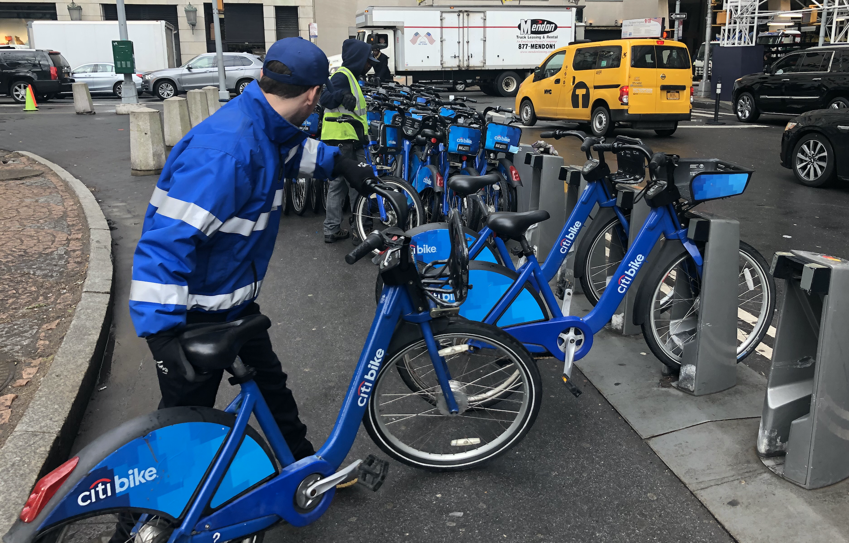
“80% of A Data Scientist’s Time is Spent cleaning the data, not analyzing it.”
Week Long Trips
145 Year Old Riders
Unknown Genders

Slide 4
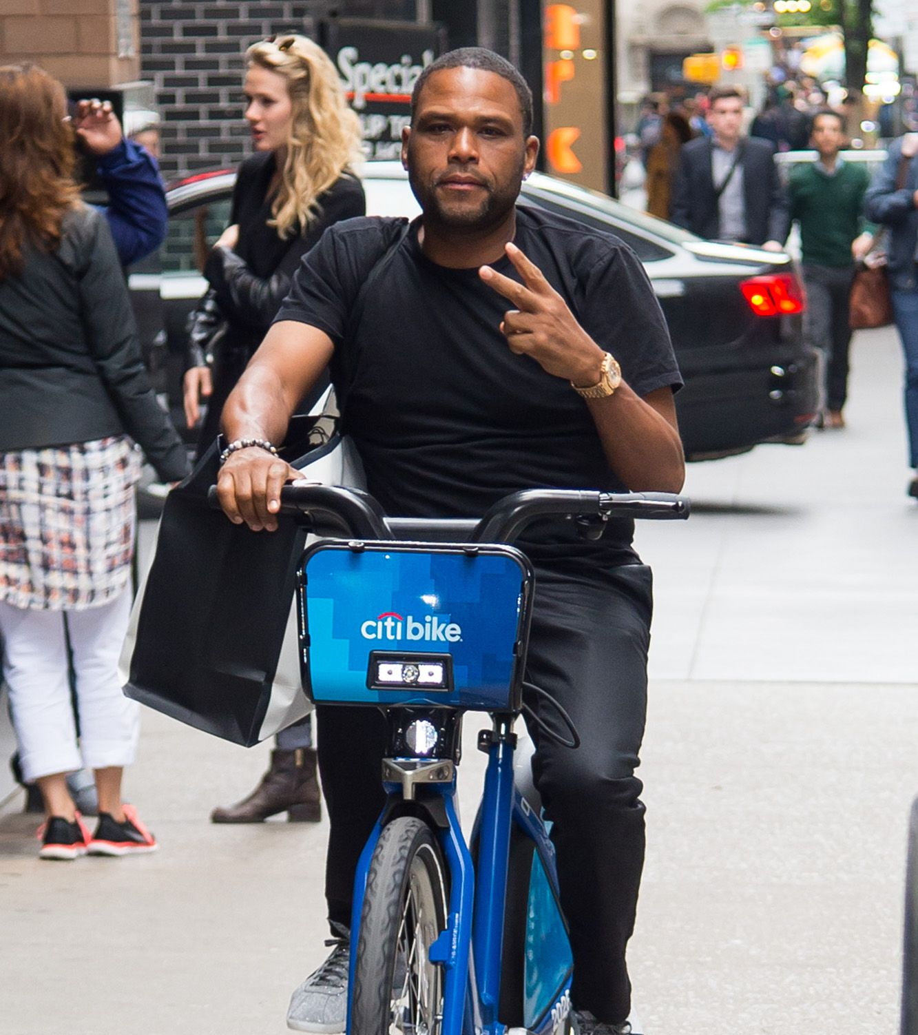
Who Exactly is Using Citi Bike?
Demographics
Generation
Age
Gender
User
Type

Slide 5

Millennials Dominate CitiBike Usage

Slide 6
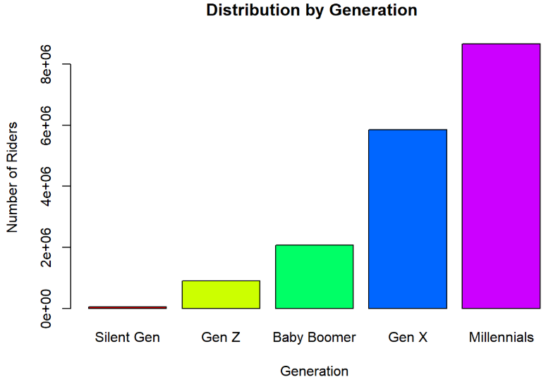
Generation bike breakdown

Slide 7
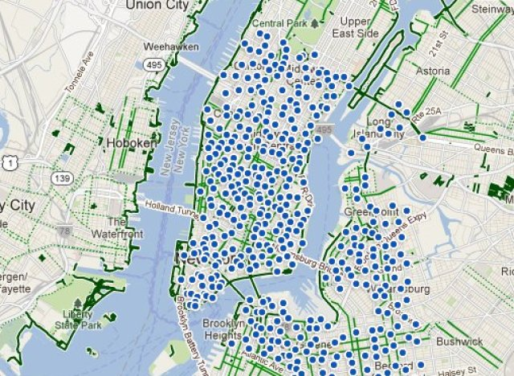
Problem: Asymmetric Ride distribution
Notes:
https://www.huffpost.com/entry/nyc-bike-share-map-citibike-station-locations_n_1509513

Slide 8
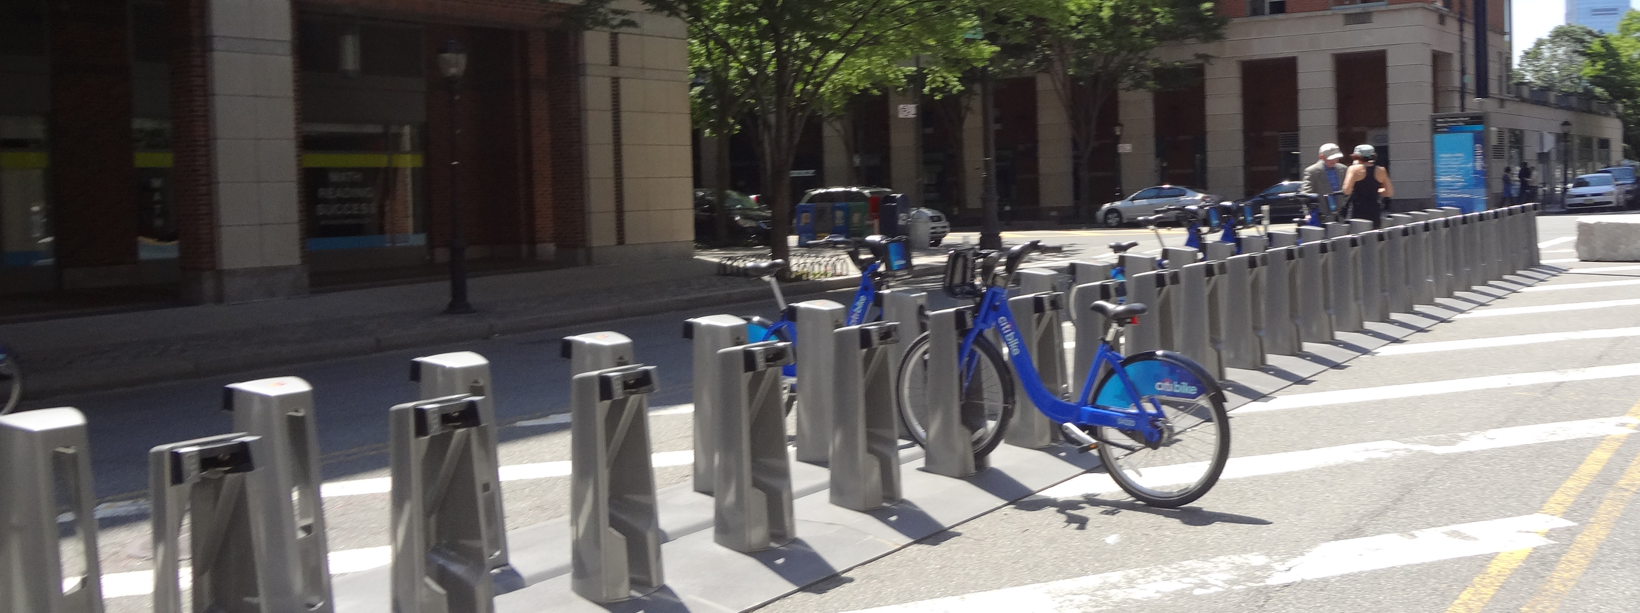
Cause: Bike Shortages in Certain Areas of the city

Slide 9
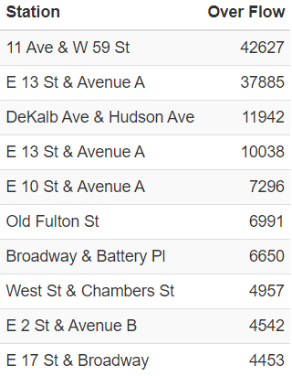
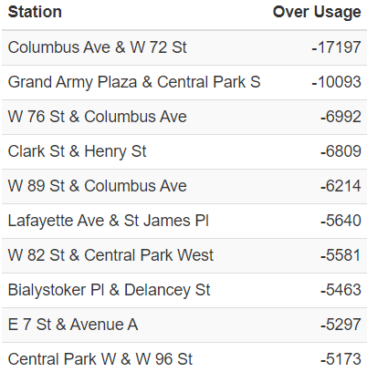
Over and Under Usage of Stations

Slide 10
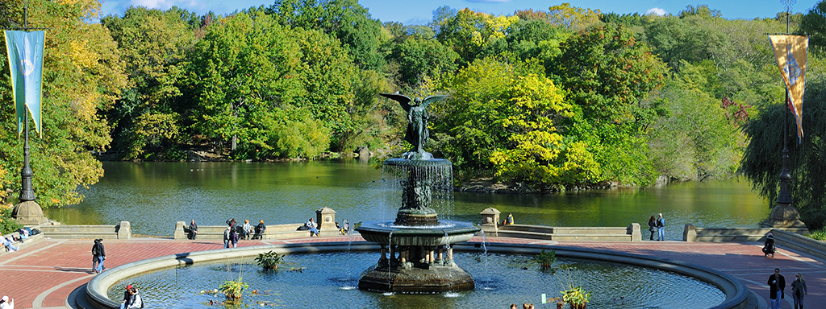
Recommendation
Redistribute bikes throughout the city during the year

Slide 11
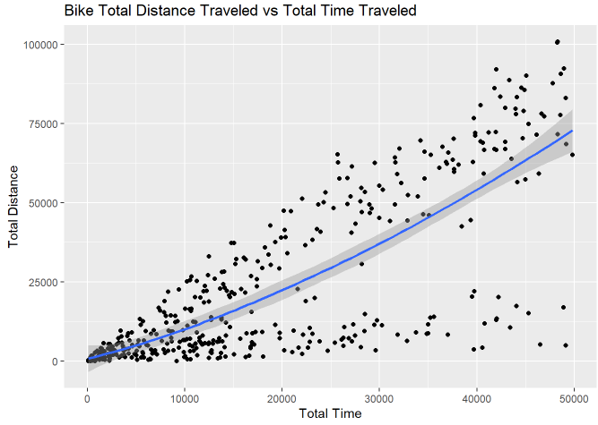
Problem: Bike over use

Slide 12
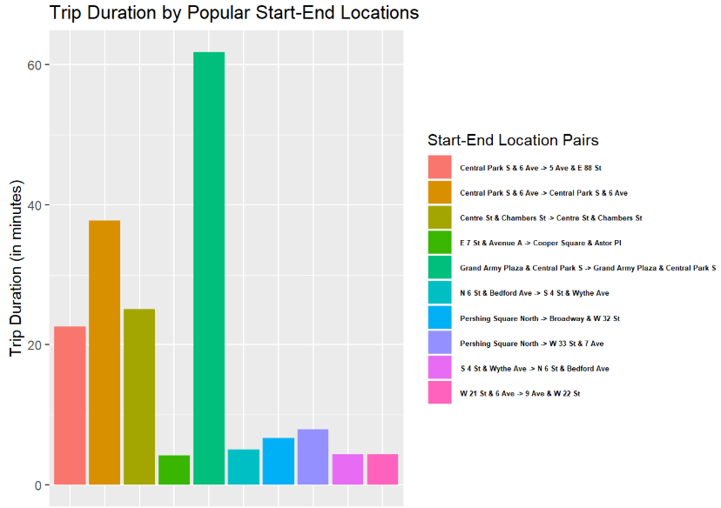
Station usage

Slide 13
Recommendation
Service and move Over used bikes

Slide 14
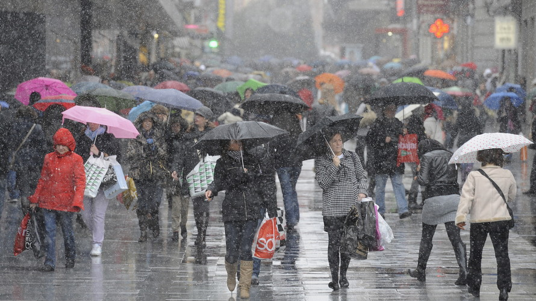

Risks

Slide 15
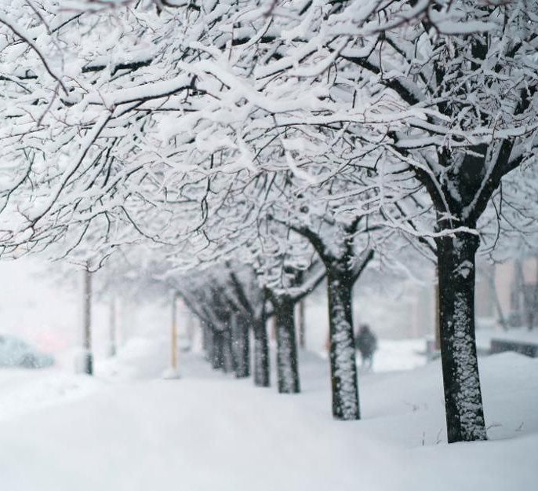
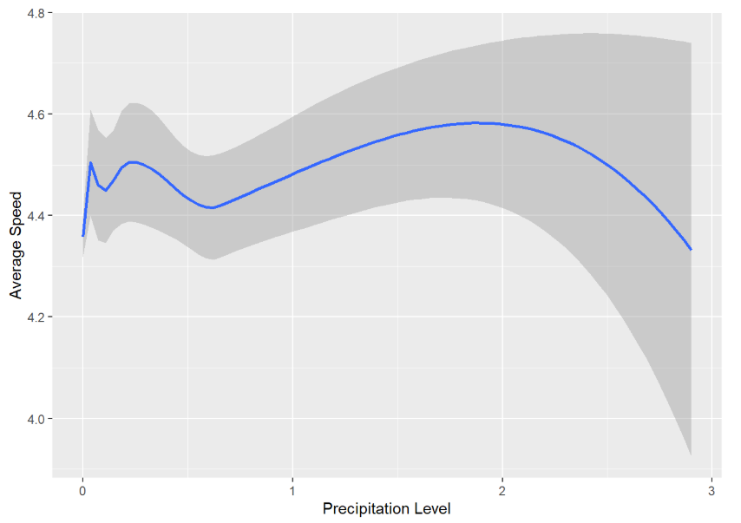
Weather May alter bike usage

Slide 16
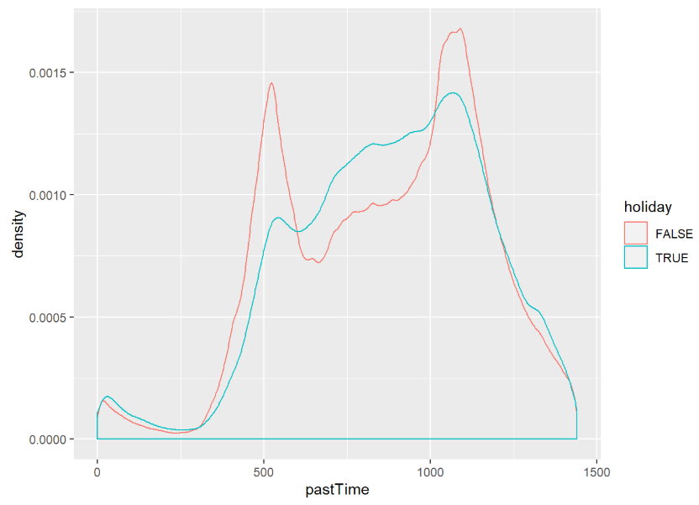
Extra: Holidays

Slide 17

Questions?

Slide 18
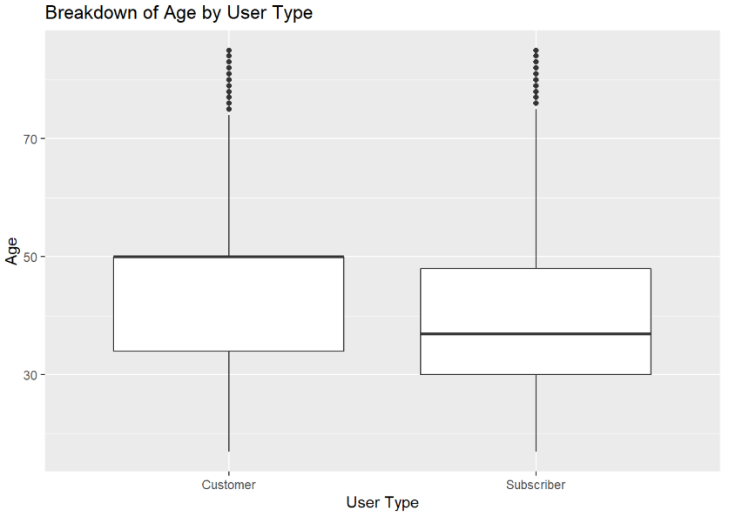
Appendix A

Slide 19
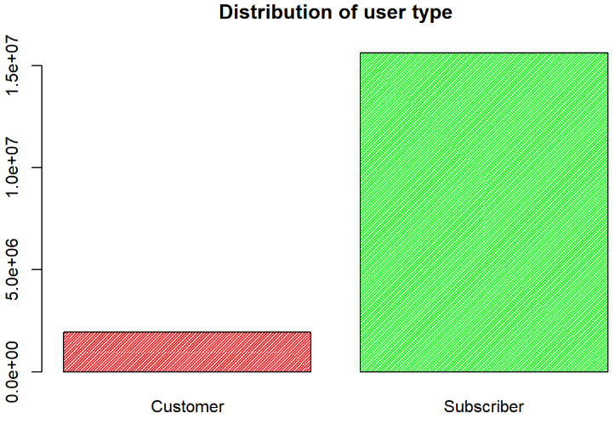
Appendix B

Slide 20
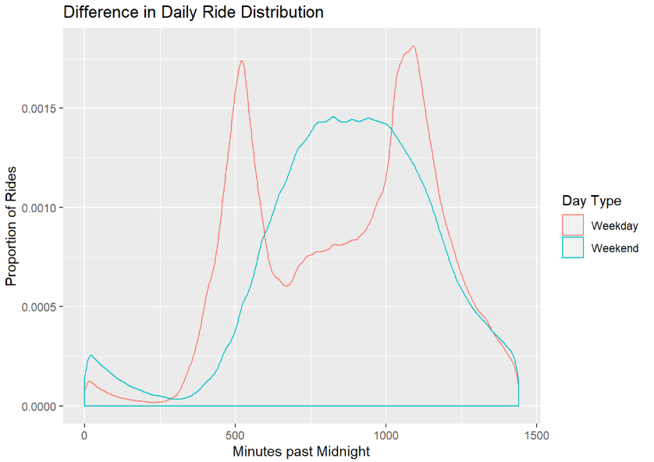
Appendix C

Slide 21
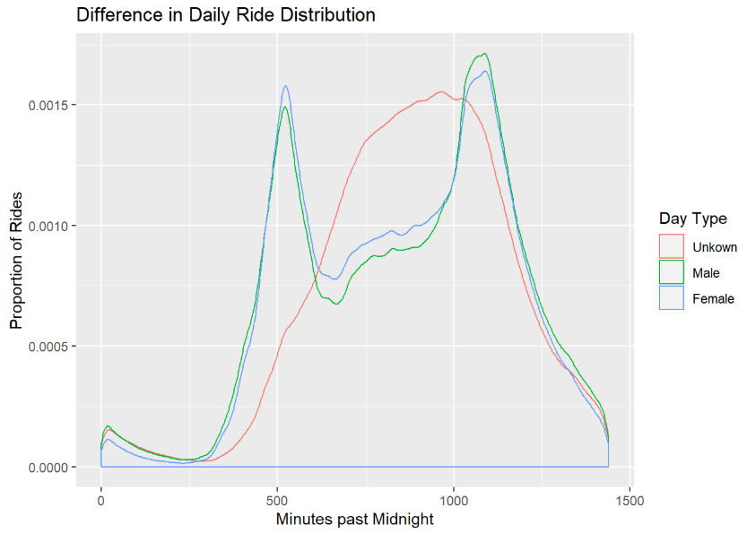
Appendix D

